Slide 1

SANJAY GHODAWAT UNIVERSITY
Kolhapur
Established under section 2(f) of UGC Act 1956
Sanjay Ghodawat University Act XL of 2017 of Govt. Maharashtra Approved by PCI, COA & AICTE
PROJECT PRESENTATION
On
“ATM INTERFACING”
By
PANKAJ KUMBHAR 22SC114281017
AVISHKAR PATIL 22SC114281019
ZAID JAMADAR 22SC114281021
BHAGYESHA JADHAV 22SC114281018
Under supervision
of Mrs. Veena Mali
Program : Btech Class : SY BTech
School of Computer Science and Engineering
S.Y 2023-24

Slide 2
Introduction
Automated teller machine enables the clients of a bank to have access to their account without going to the bank. This is achieved only by development and application using online concepts. When the product is implemented the user who uses this product will be able to see all the information and service provide by the ATM, when he enters the necessary option and arguments. The product also provides services like request for cheques, deposite cash and other advanced requirements of the user. The data is stored in the data base and is retrieved when never necessary.

Slide 3
Problem Definition
The system mainly used by the bank clients. When a client comes to ATM center to update and delete their account. It reduces the time consumption and lot of paperwork.
For any single operation it involves numerous references and updating also takes subsequent changes in other places.

Slide 4
Objectives
The render accurate services to customer.
The reduction of fraudulent activities.
To achieve speedy processing of customer data.
To reduce error processing, the guarantee of increase security.

Slide 5
Scope
As per RBI, for ATM industry, India is a huge market. It is place with 1.2 billion people, where 40% of them were unbanked. ICICI bank General manager OP Srivastava once commented: “where we saw a man in a dhoti in a remote town in South India withdraw money from an ATM, tuck it in the folds and the ride on his cycle, we were truly inspired by the ATM growth in the country.”
There is a huge opportunity for growth of ATM market in India. The future will seen multi vendor ATM popularity, which will provide personalized features and a user friendly interface. ATM will be popular “public technology”. Original equipment manufactures and vendor will get ample scope for handling ATM machines. Modern ATM are capable of personalized branding, CRM application, integrated fraud alert, customer notifications, and flexible services.

Slide 6
Problem Identification
The system mainly used by the bank clients. When a client comes to ATM center to update and delete their account. It reduces the time consumption and lot of paperwork.
For any single operation it involves numerous references and updating also takes subsequent changes in other places.

Slide 7
System requirement specification
Software Requirement:
Turbo C
Microsoft Visual Studio Code
Dev C++
HARDWARE REQUIREMENT
Computer or laptop
Intel(R)Core(TM)i3-Processor
RAM-1 GB Minimum
Storage-100GB

Slide 8
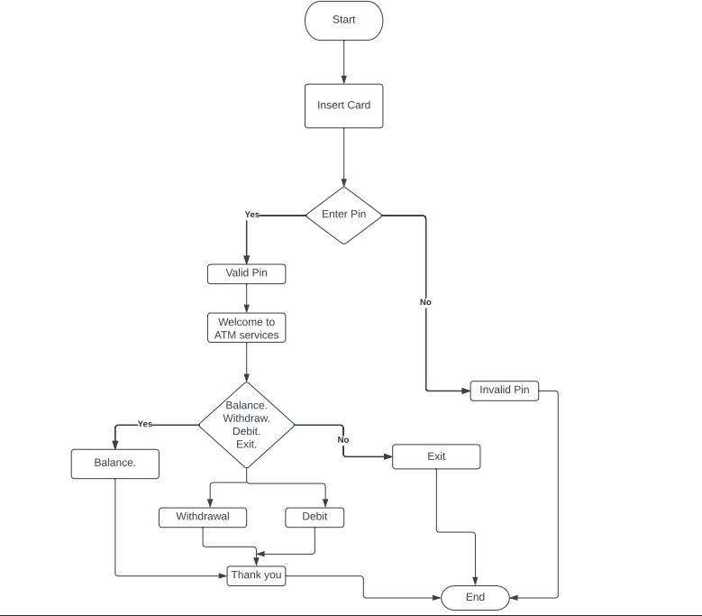
Flowchart

Slide 9
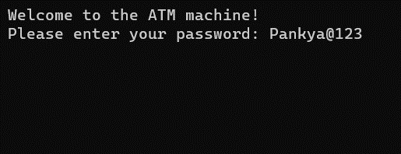
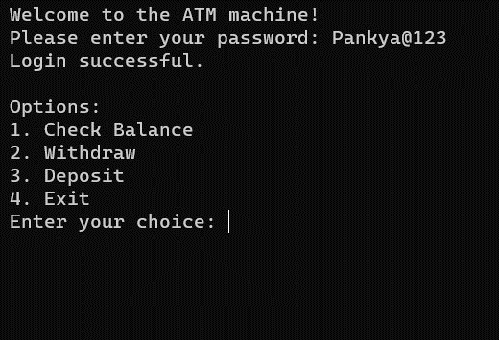
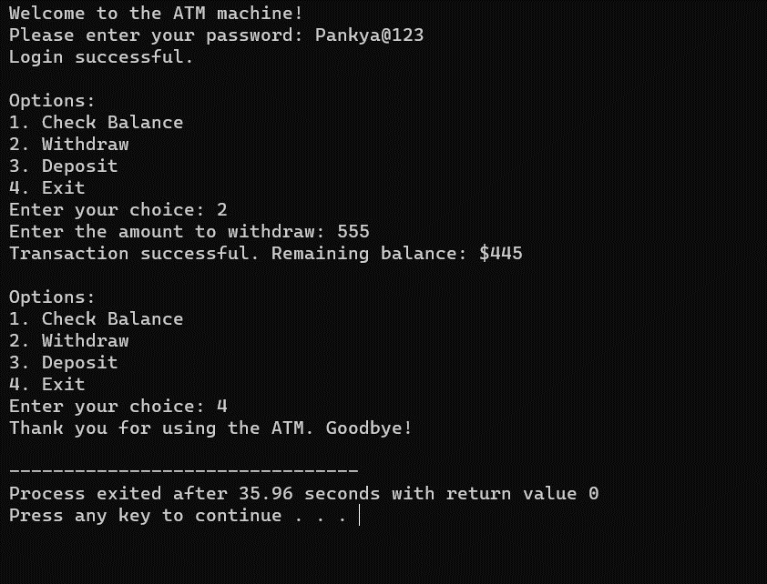
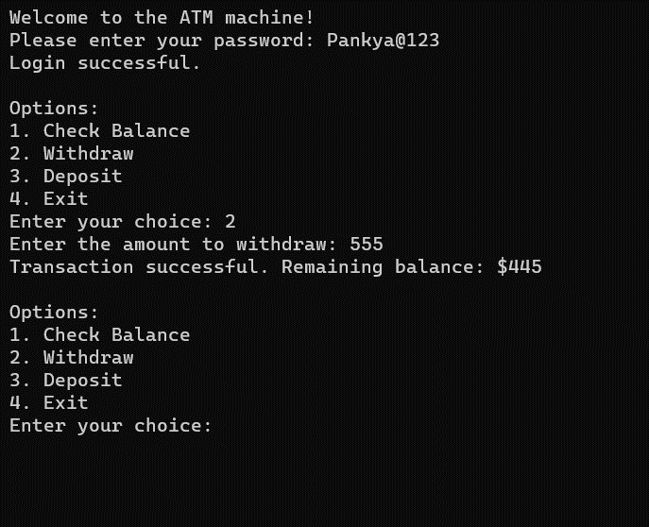
Output design

Slide 10
Advantages
Easy bill payments
Quick balance check
Reduced workload for bank employees
Fast transactions

Slide 11
Future Scope
The global ATM industry is mature. Given the glut of global capacity, manufacturers are betting heavily on product extensions and non-hardware futures including "ATMs as a Service," recycling ATMs, FI core replacement acceleration, crypto ATMs, self-service checkout, hospitality automation and gambling kiosks.

Slide 12
Conclusion
The conclusions from this study, based on the findings, are given below. Proposed Proposed fingerprint and PIN system works perfectly with 94%, FAR 4%, FRR 2%, TER 6% and GAR 98%. Compared to other fingerprint identification systems and verification systems, the proposed system provides improved simultaneous performance and partial elimination of false minutiae on its fingerprint site. The proposed system is a good way to charge the cost of starting a secure ATM transaction to protect ATM users from fraudsters.The recommendations of this study can be summarized as follows: Decision-makers need to value a guaranteed level of security through biometric systems and the potential for change between perception and reality.

Slide 13
References
http://www.vbdotnetheaven.com
https://www.elprocus.com/automated-teller-machine-types-working-advantages/
https://www.codewithc.com/atm-banking-system-asp-net-project/
Books:
Let’s C++
C++ Programming Absolute Beginner's Guide

Slide 14
Thank You

